Slide 1
Practice Questions
Bayes Theorem and Paradoxes

Slide 2
Question 1
The odds of being struck by lightning are 1:1 million. 10% of People struck by lightning were hiking above the tree level during storm. 1% of people who were not struck by lightning were also hiking above the tree level during storm. What is the posterior odds of being struck by lightning if you do hike above tree level during a storm?

Slide 3
Answer
We have,
Prior odds=P(struck)/P(not struck)= 1/1 million
P(hiking above tree level |struck)=10/100
P(hiking above tree level |not struck)=1/100
Likelihood Ratio=P(hiking above tree level | struck)/P(hiking above tree level | not struck)=10/1=10
POSTERIOR ODDS = LIKELIHOOD RATIO * PRIOR ODDS
Posterior odds, P(struck|hiking above tree level)/P(not struck|hiking above tree level)= Likelihood Ratio * Prior odds = 10* 1/1 million= 10/1 million

Slide 4
Question 2
You sat in a café near the person who had a flu. Assuming that prior probability of getting a flu is 0.0001, what would you need to know in order to calculate the probability that you get a flu, knowing what you know (you sat in a café next to a person who had a flu).

Slide 5
Answer
Write down the Bayes Theorem for this particular question first:
P(flu | sat next to flu)= P(sat next to flu | flu) * P(flu)
P(sat next to flu | flu) * P(flu) + P(sat next to flu | not flu) * P( not flu)
Given: P(flu)
Need the rest of the conditional probabilities.

Slide 6
Question 3
The odds of getting a table in Starbucks are 2:3. But the odds of getting a table during rainy Sunday afternoon are only 1:99. What is the likelihood ratio and how it is computed (explain)?

Slide 7
Answer
We have,
Prior odds=P(getting table)/P(not getting table)= 2/3
Posterior odds= P(getting table |rainy sunday)/P(not getting table|rainy sunday)=1/99
POSTERIOR ODDS = LIKELIHOOD RATIO * PRIOR ODDS
Likelihood ratio= Posterior odds / Prior odds= (1/99) / (⅔)= 1/66

Slide 8
Question 4
You have very high fever, What is the probability that you have contracted ebola virus? You are concerned because you have recently spent several hours at Newark Airport. Probability of passenger with ebola showing up at Newark Airport is 10^-7. Conditional probability of having high fever when having ebola is 1 (100%), and otherwise it is 10^-4.

Slide 9
Answer
P(ebola | very high fever)= P(very high fever | ebola) * P(ebola)
P(very high fever | ebola) * P(ebola) + P(very high fever | not ebola) * P( not ebola)
= 1 * 10^(-7)
1 * 10^(-7) + 10^(-4) * (1-10^(-7)

Slide 10
Question 5
People from computer science like using Linux-based operating systems, they call themselves geeks. For example, in Rutgers, 5% of students are from computer science department, 80% of use Linux based operating systems in daily life. For those students who are not from computer science, only 1% of them use Linux-based operating system. One day, you find someone using strange Linux-based operating system in the dining hall, how much confidence can you say he is from computer science department?

Slide 11
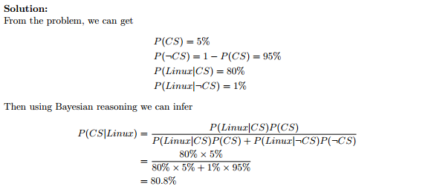
Answer

